Slide 1
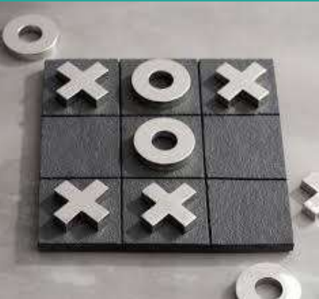
DSCI-6612-02 Intro to Artificial Intelligence Tic-Tac-Toe
Professor:
Vahid Behzadan
Team Members:
Nithish Kumar Mayavan
Jayakrishna Chinthaginjala

Slide 2

Project Topic
Tic-Tac-Toe: A Game of Strategy
Two participants take turns placing X or O symbols on a 3x3 grid, aiming to form a winning sequence of three marks horizontally, vertically, or diagonally.
Key Concepts
Knowing the possibility of various outcomes is known as probability.
Predictability is known as Using strategic planning and anticipating to make decisions.

Slide 3

Objectives
Developing a Tic-Tac-Toe adversarial search algorithm and reinforcement agents
AI Design Agents
Min-Max Algorithm
Alpha-Beta Pruning
Determine the best tactic for Tic Tac Toe by iteratively testing algorithms.
To decide whether the algorithm performs better—adversarial search or reinforcement learning—define performance metrics for each method and compare the outcomes.

Slide 4
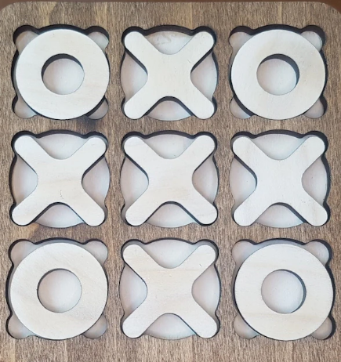
AI Approaches for Tic-Tac-Toe
Adversarial Search Strategies
Implementing Adversarial Search Strategies as our second approach.
Min-Max Algorithm
Alpha-Beta Pruning
Chosen Language
Python

Slide 5

Deliverables
The Tic Tac Toe game implementation using Min-Max, Alpha-Beta, and Reinforcement Learning Agents is described in detail in the User Documentation model.
Python programming language was used to create algorithms for A I Agents (.py files)
Link to the Python code and related files on GitHub.
A YouTube video that shows how the project is implemented with slides

Slide 6

Evaluation Methodology
The execution of every A I agent is the basis for project evaluation.
To identify the most effective agent, determine how many times the corresponding agent has won by playing one-on-one.
A table that compares the three agents based on their win percentage, Tic Tac Toe moves, and corresponding scores.
Charts showing the differences in performance.
Comparing the three agents' time and space complexity

Slide 7

Thank You!

